Slide 1
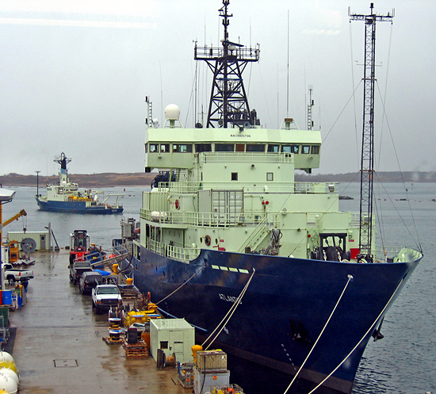
Ship-board Flux Measurements made during CalNex 2010 C.W. Fairall , D.E. Wolfe, S. Pezoa, L. Bariteau, B. Blomquist, C. Sweeney
Air-Sea flux measurements were made from the research vessel Atlantis during the California Air Quality Study (CalNex 2010) off the California coast from San Diego to San Francisco Measurements included sensible and latent heat fluxes in conjunction with long and short-wave incoming solar radiation, total precipitable and liquid water, remote sensing of the clouds, and thermodynamic and wind profiles from radiosonde launches to capture the boundary layer structure. As can be seen in Fig. 1 a diverse and complicated set of data were collected in such regions as the harbors of San Diego, Los Angeles, and San Francisco, the Sacramento ship channel, coastal transects, and the open ocean. The two major study areas were just off the coast of Los Angeles where the ship spent 16 days and in the San Francisco bay/ Sacramento ship-channel for 5 days. Figure 2 shows hourly averaged data of the meteorological conditions encountered. Boundary layer conditions are summarized in Figure 2 which is a composite of the theta profiles calculated from the 79 radiosonde launches made during CalNex.

Slide 2
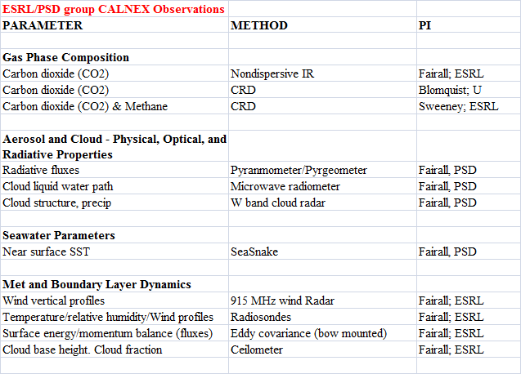
Basic Observation Summary

Slide 3
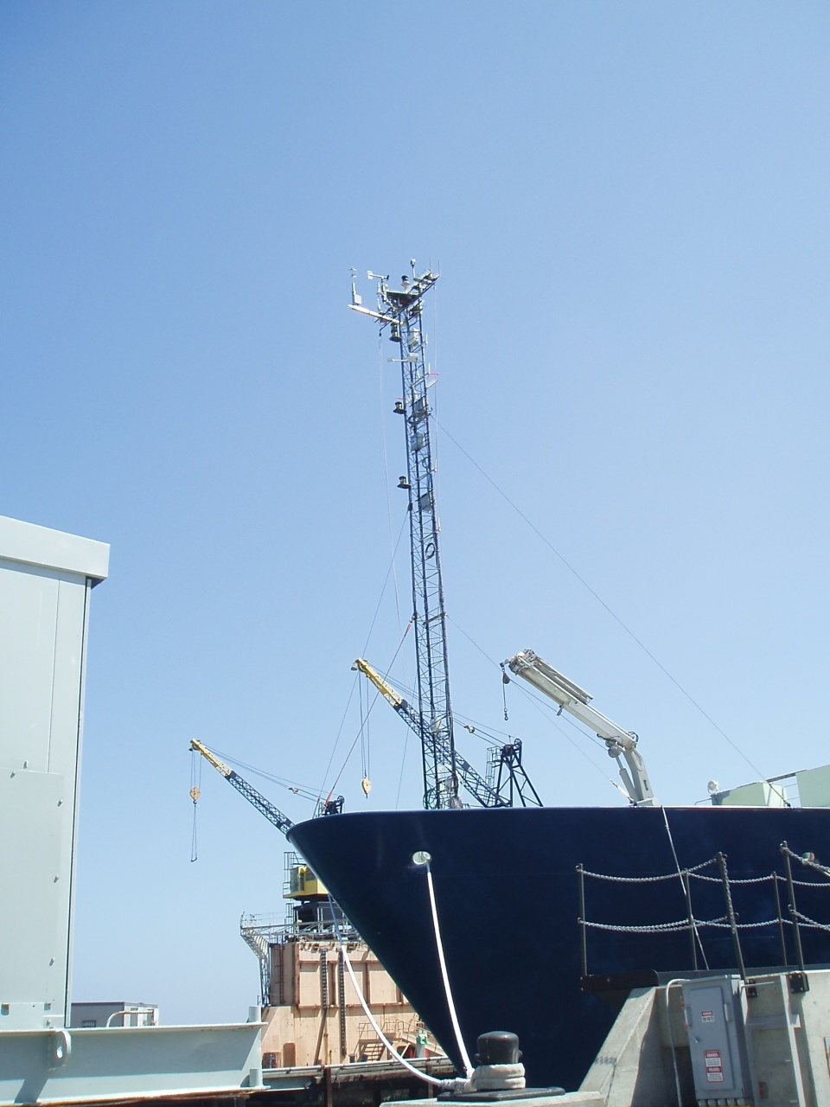
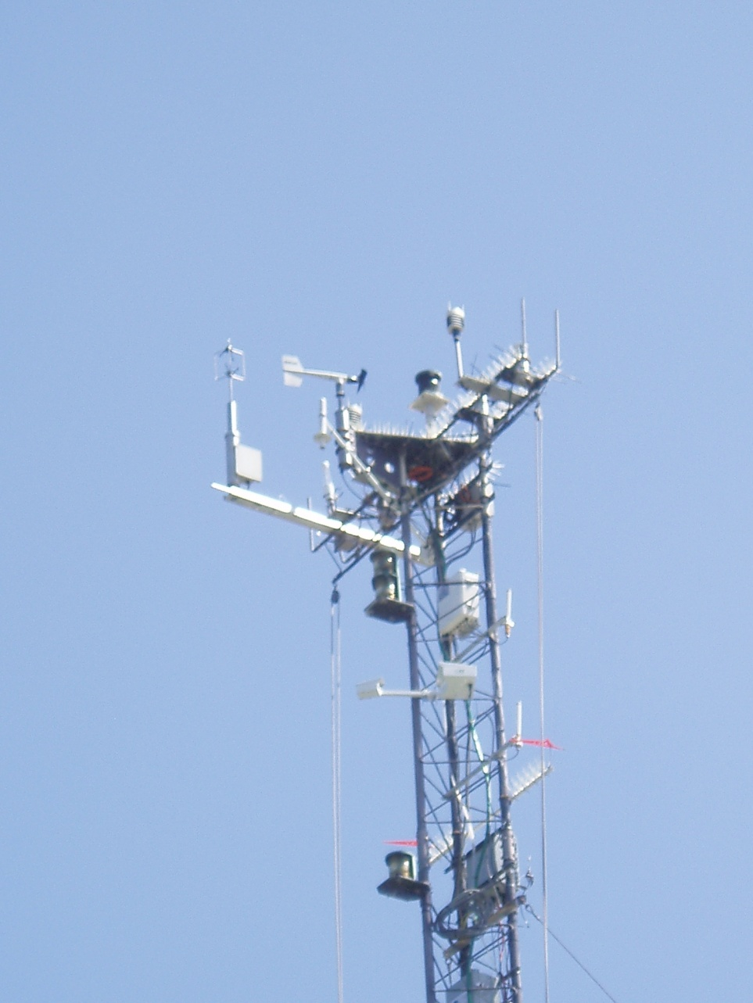
Flux and Near-surface Meteorological Sensors

Slide 4
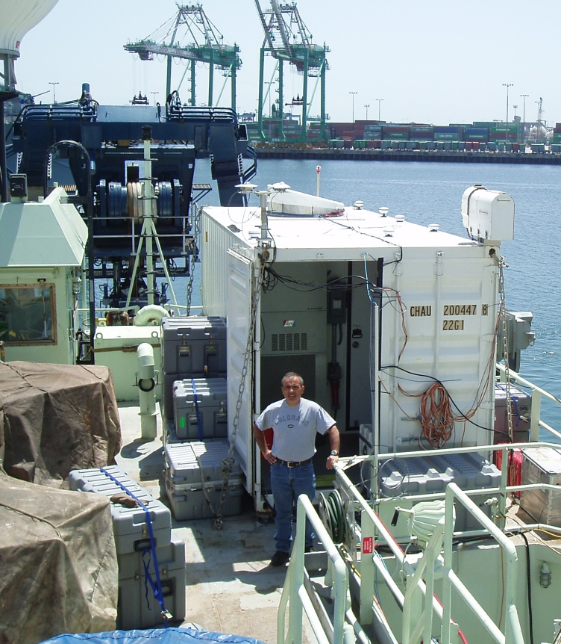
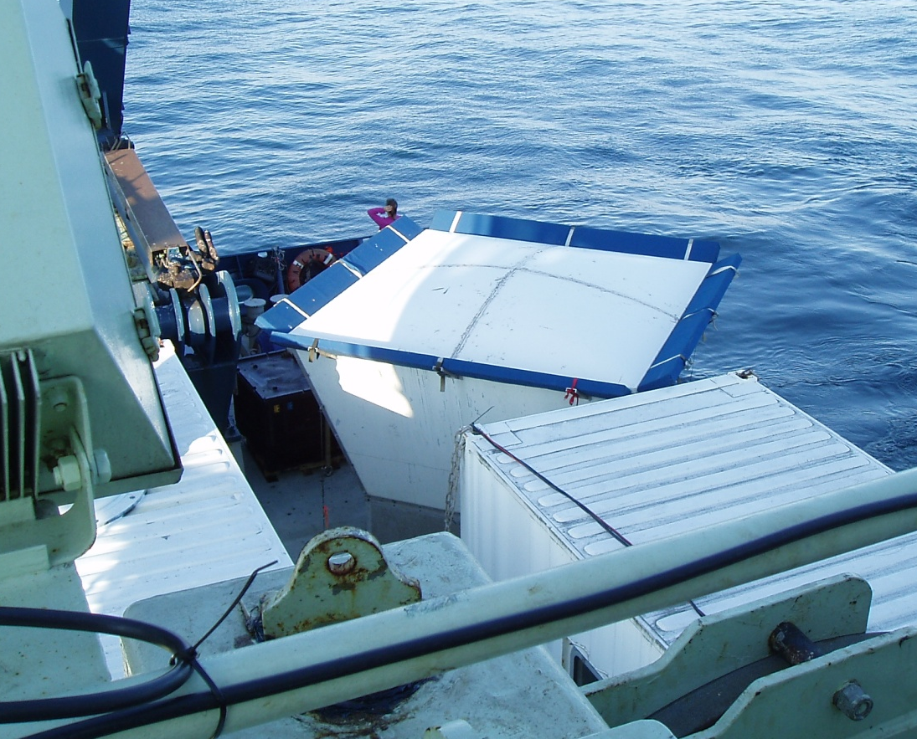
Doppler Cloud Radar and Wind Profiler

Slide 5
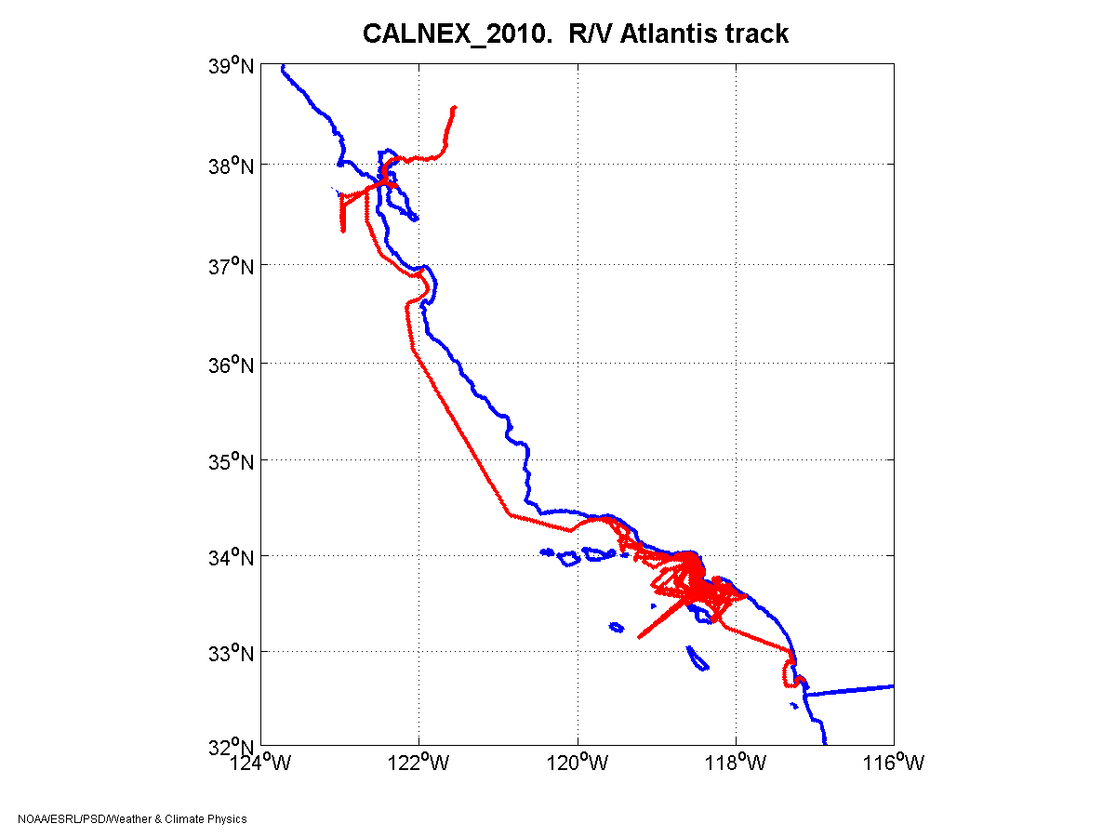
Sacramento
Region Date DOY
A May 14 134
B May 15 – May 31 135-151
C June 2 152
D June 3-8 154-159
San Francisco
D
C
Monterey
Santa Barbara
Los Angeles
B
San Diego
A

Slide 6
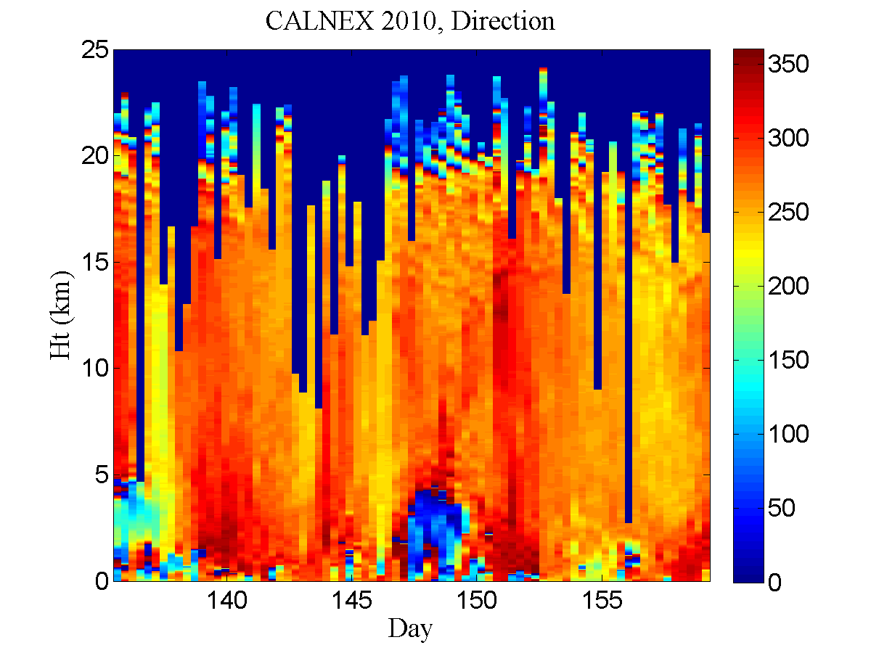
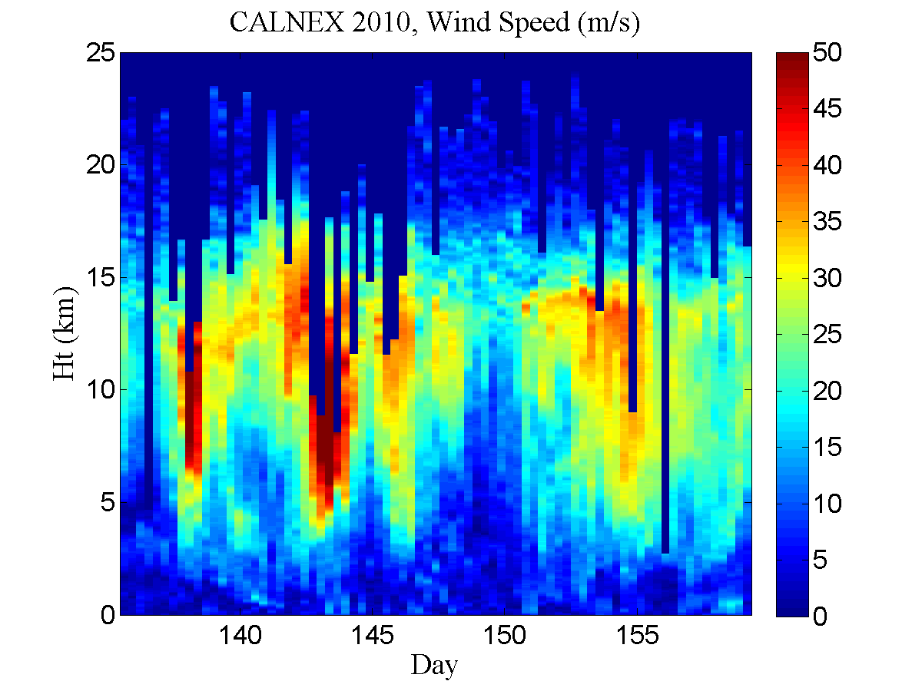
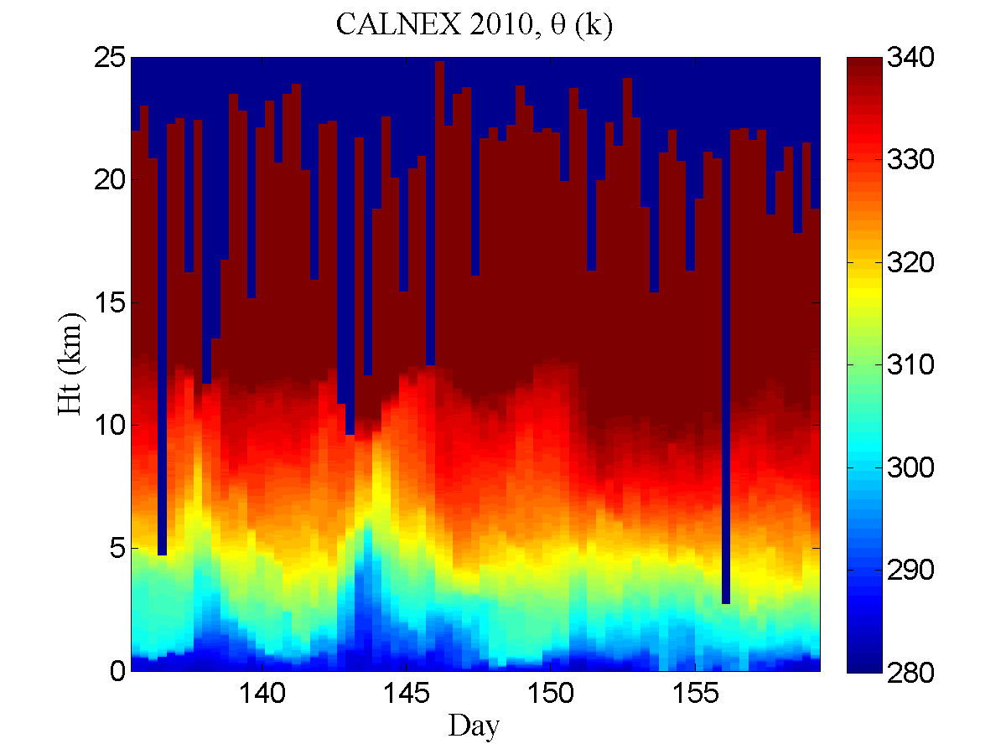
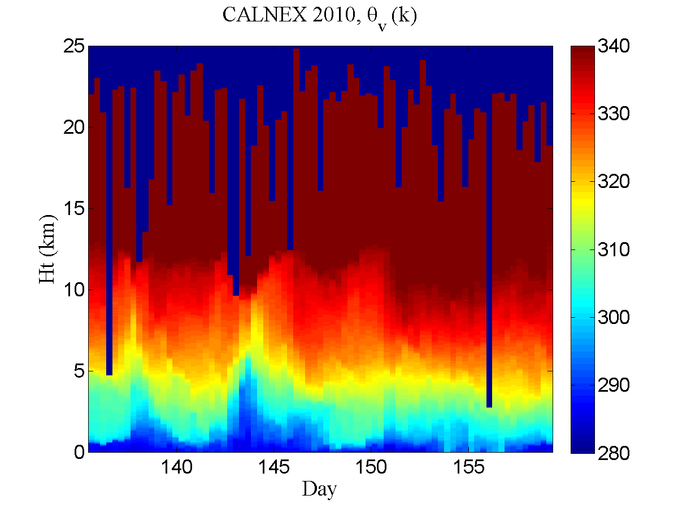

Slide 7
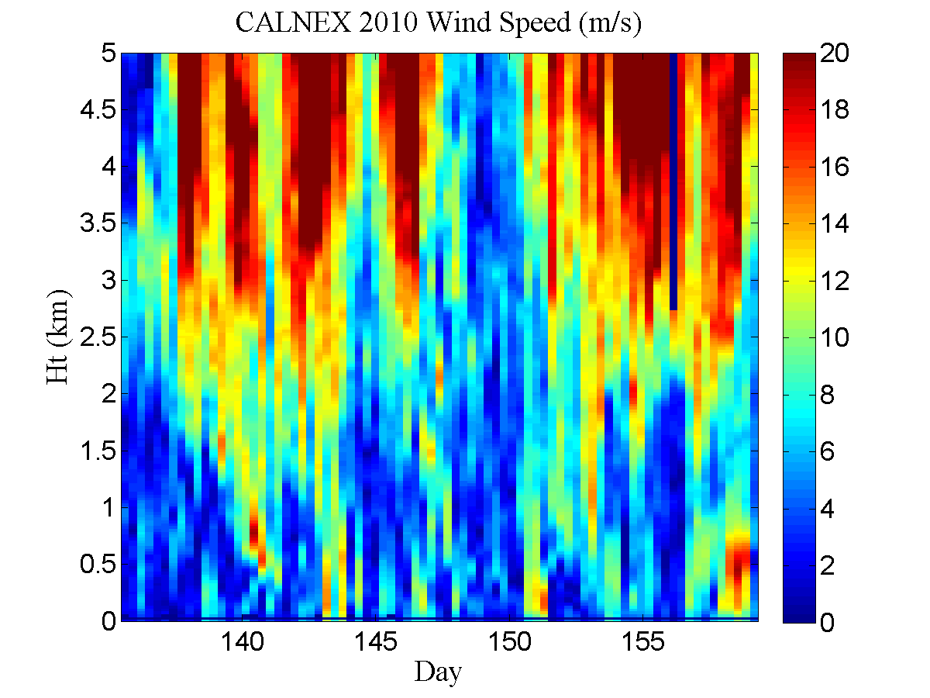
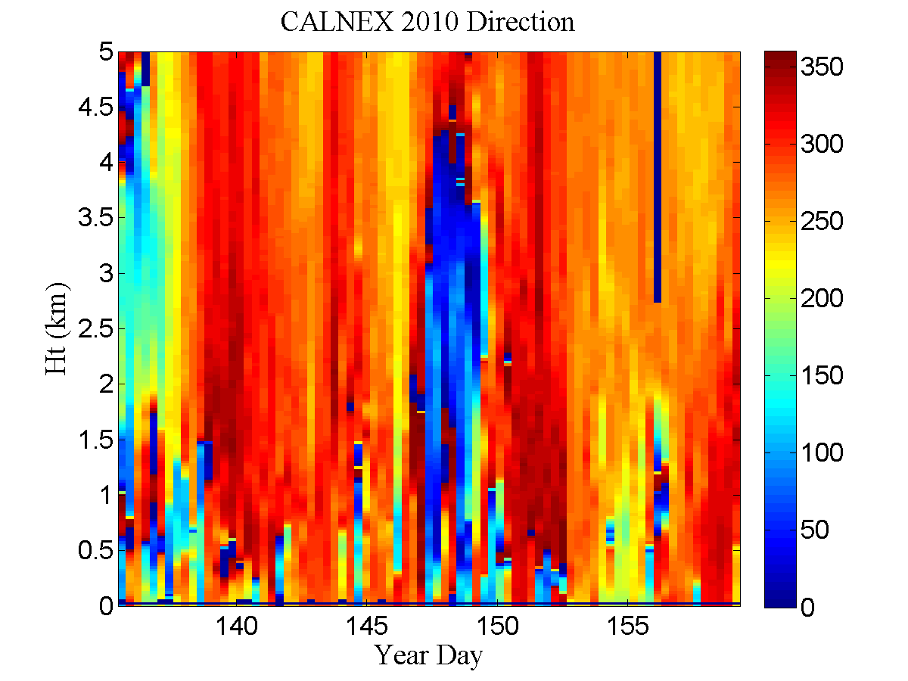
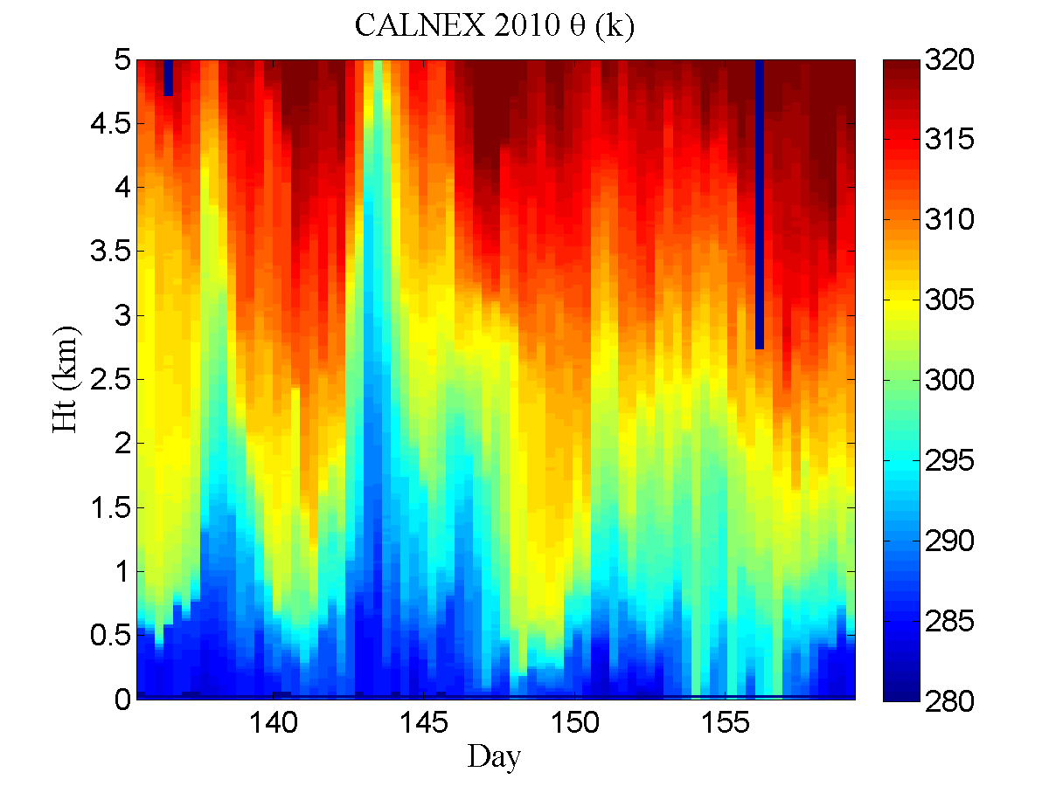
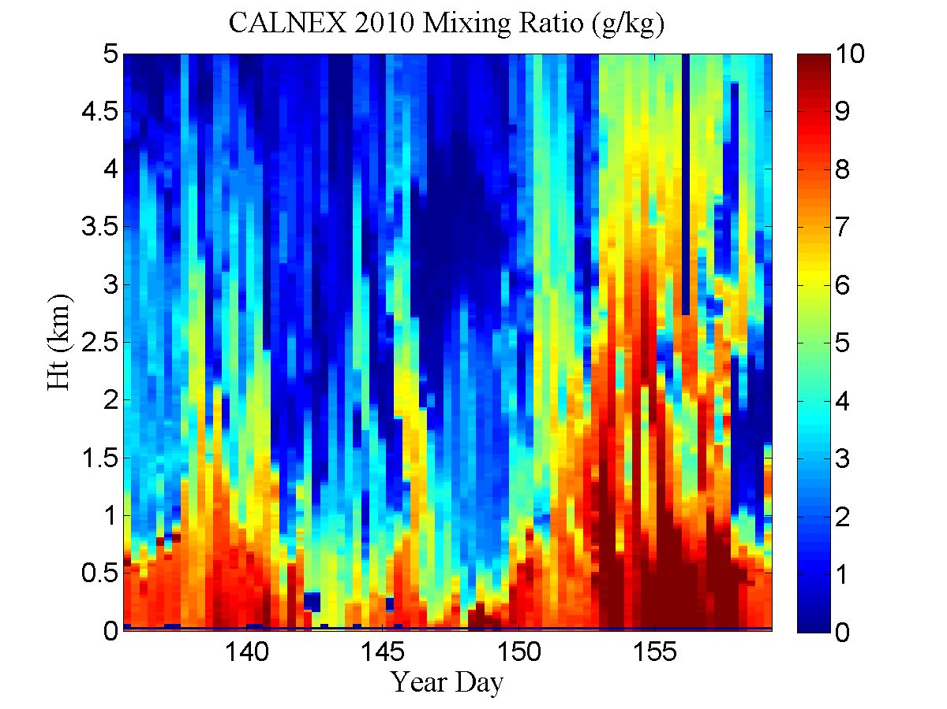
Balloon Soundings – Low Altitude

Slide 8
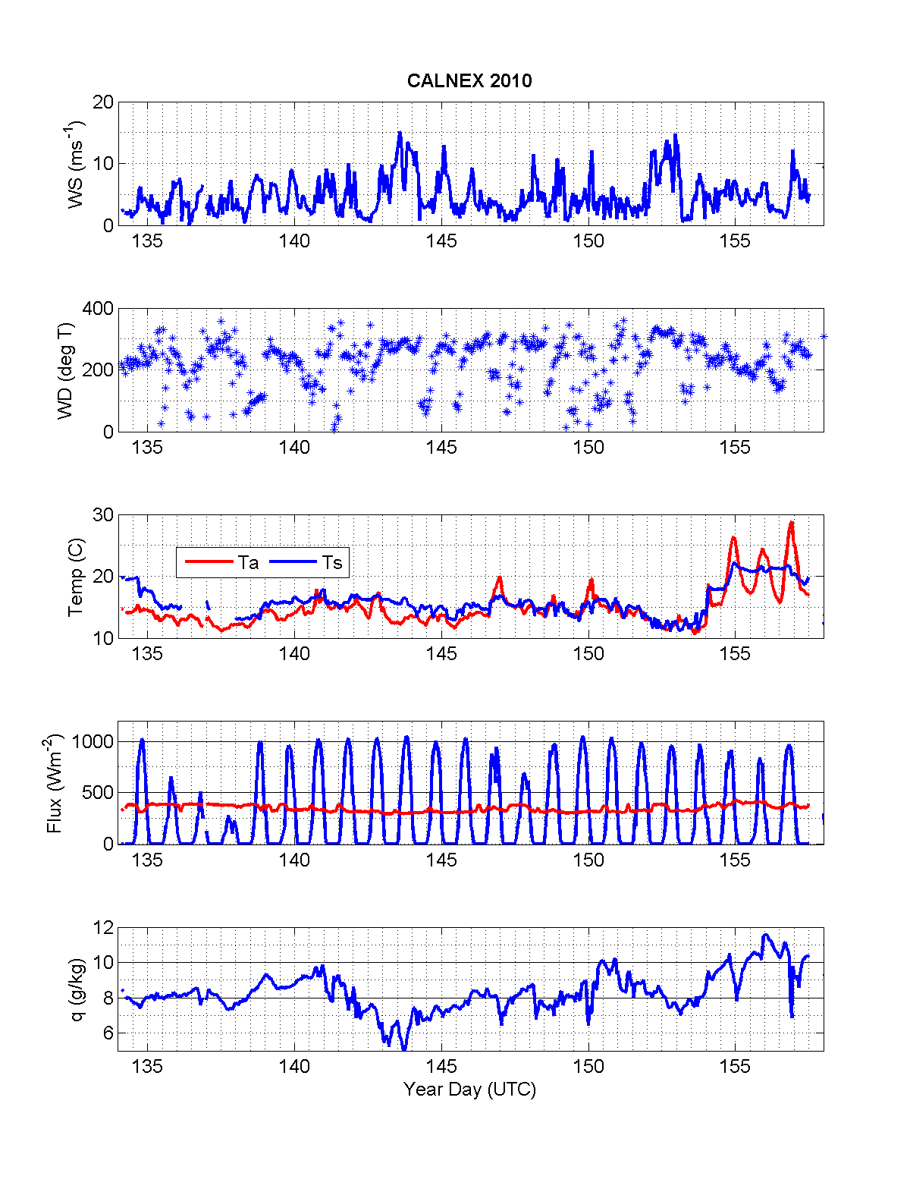
Basic Near-Surface Meteorology
A
B
C

Slide 9
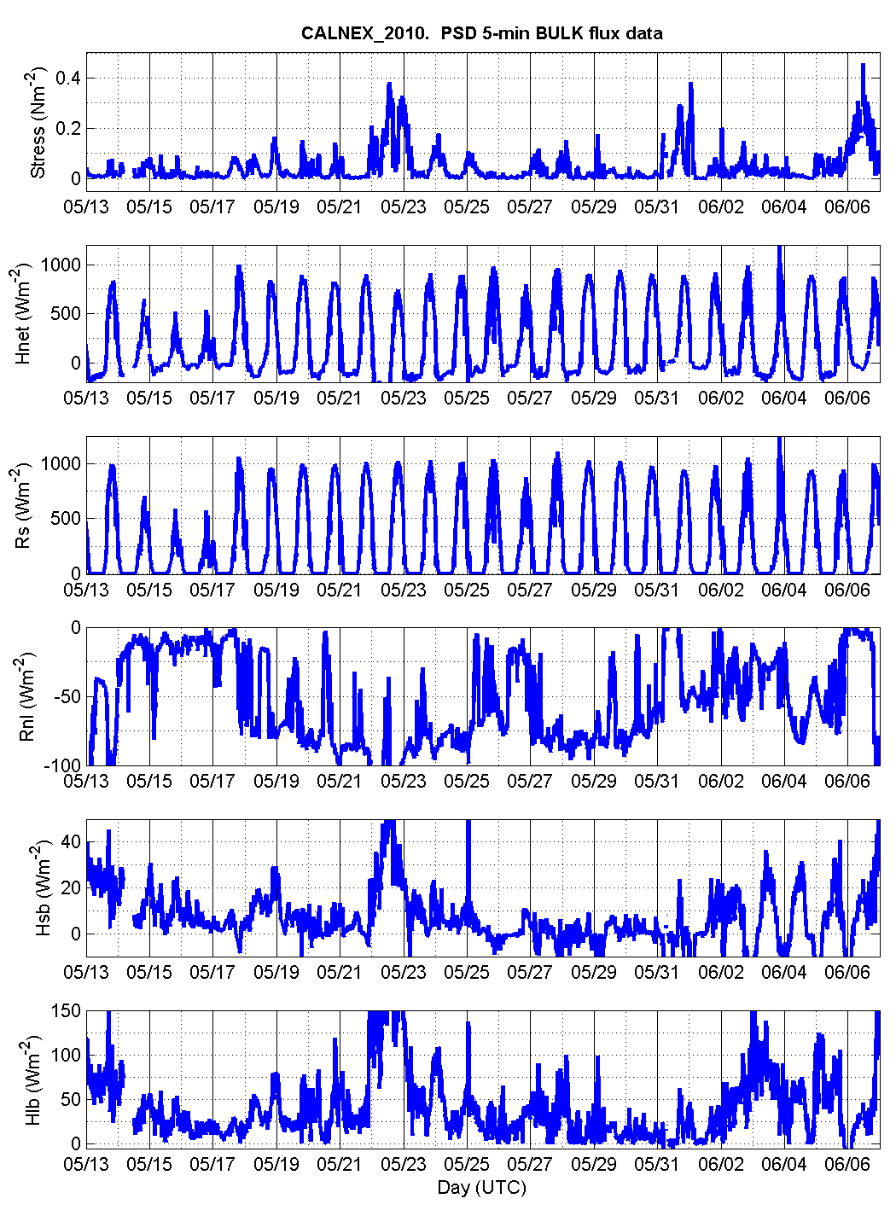
Surface Fluxes

Slide 10
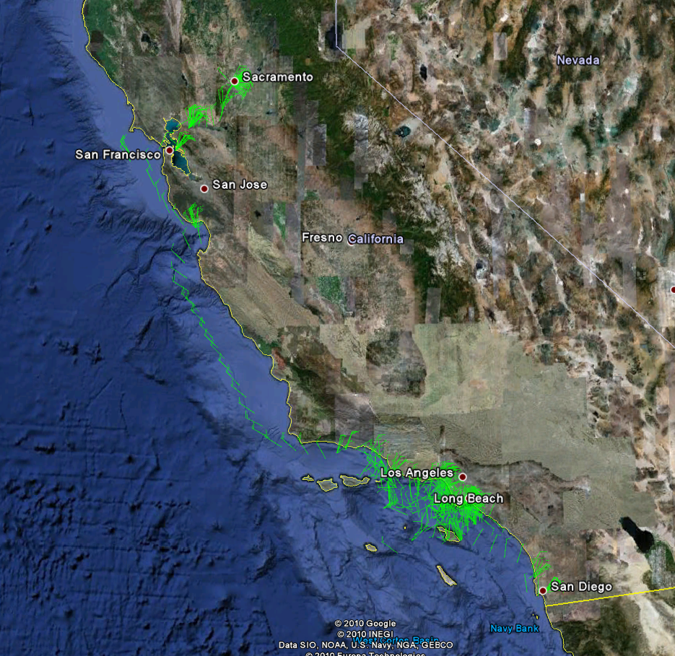
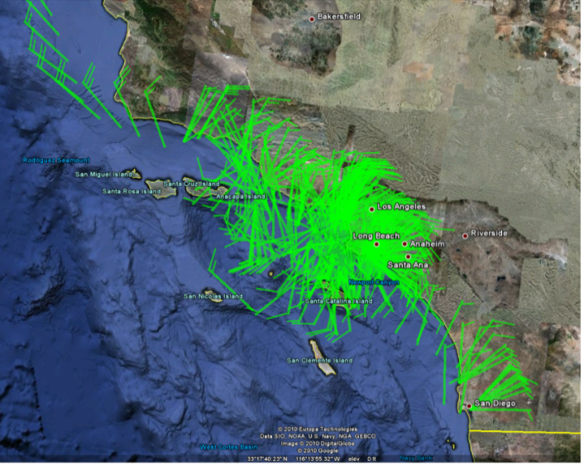
CALNEX Wind Barb Plot
C
B
A
Each half pennant represents 5 knots (1 knot = 0.51 m/s) each whole pennant represents 10 knots; each flag represents 50 knots (which we should not see on that cruise). Max was ~30 knots.

Slide 11
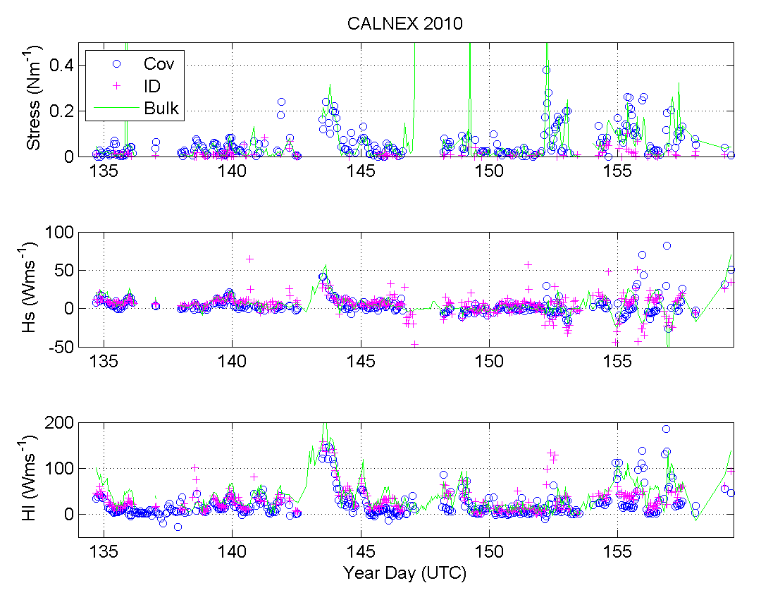
Direct Turbulent Fluxes
A
B
C

Slide 12
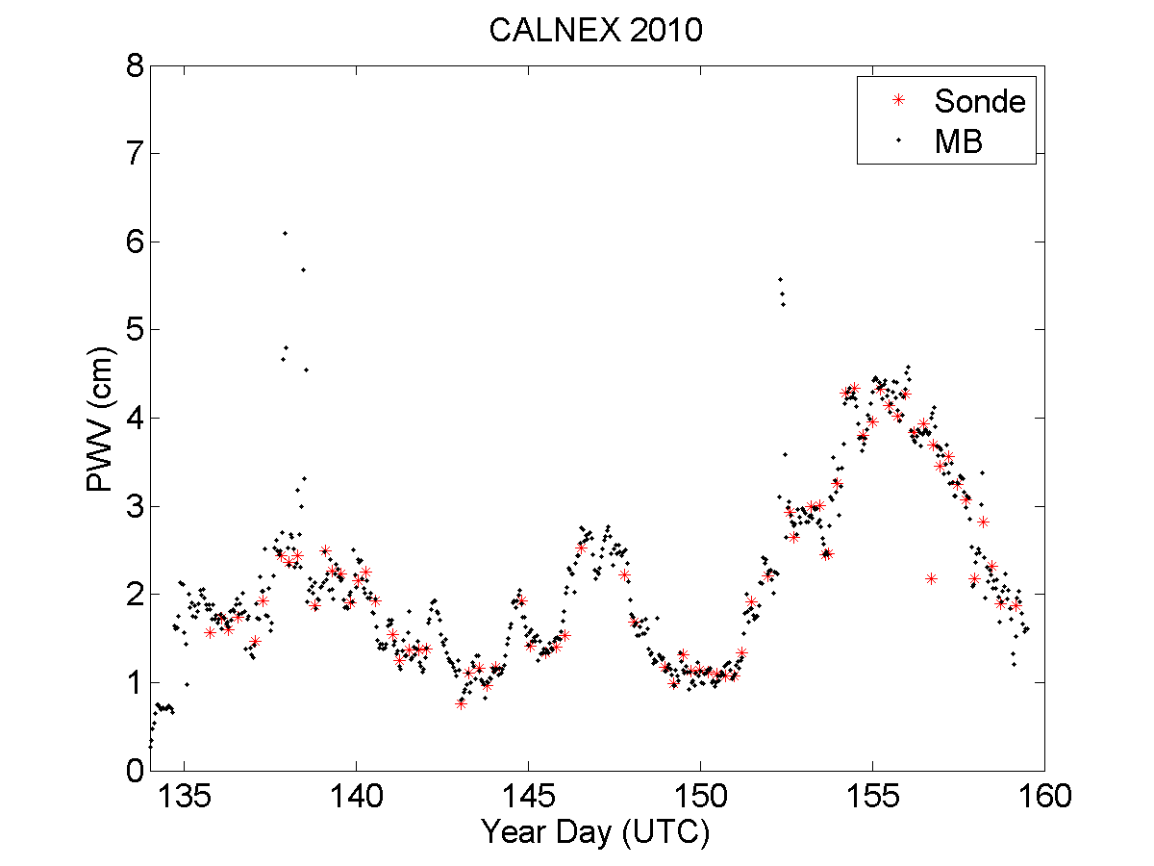
Column-Integrated Water Vapor (Precipitable Water)
Region B
Region D

Slide 13
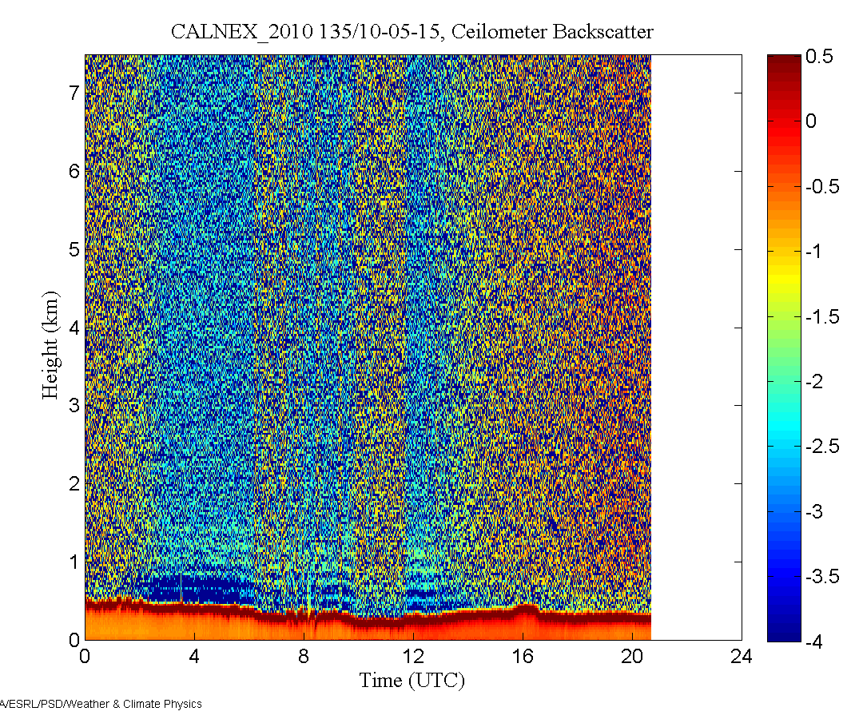
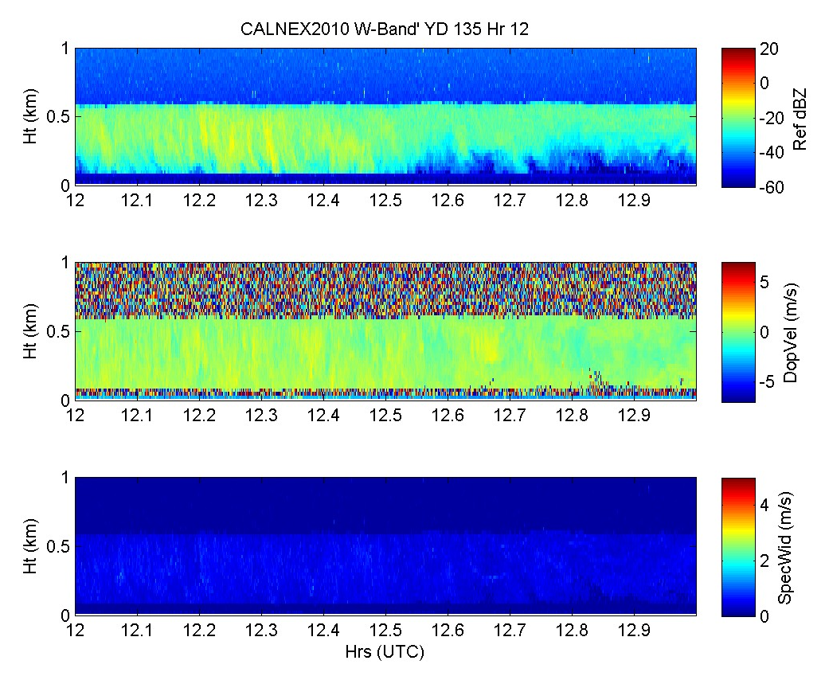
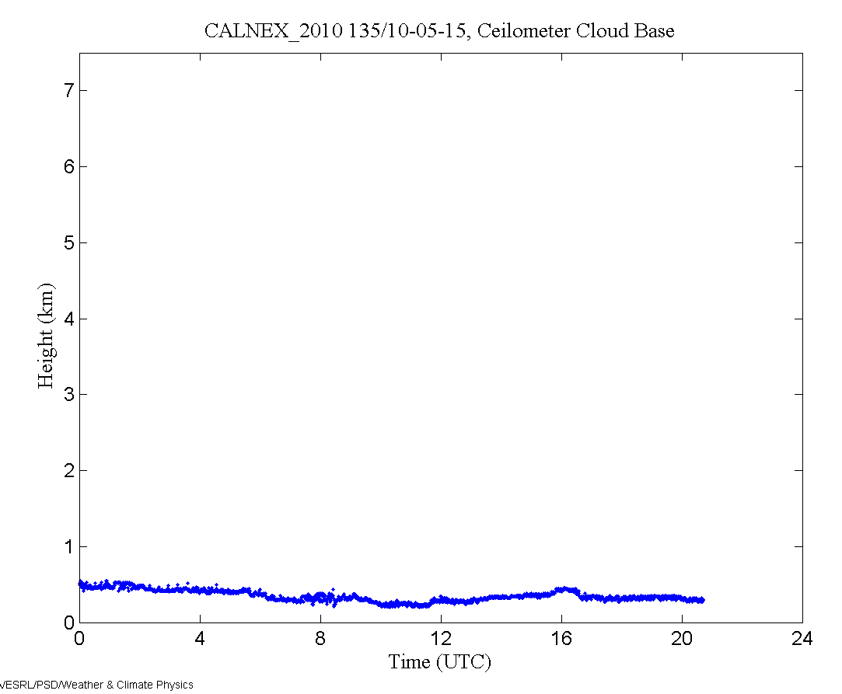
Cloud Views
Time-height cross section from 1 hour of data beginning at 1200 on May 5 from ESRL/PSD W-band cloud radar. The top panel is the radar reflectivity (dBZ); the middle panel is the mean Doppler velocity (m/s, positive down); the bottom panel is the Doppler width (m/s) of the return.
Time series of ceilometer cloudbase height for May 15.

Slide 14
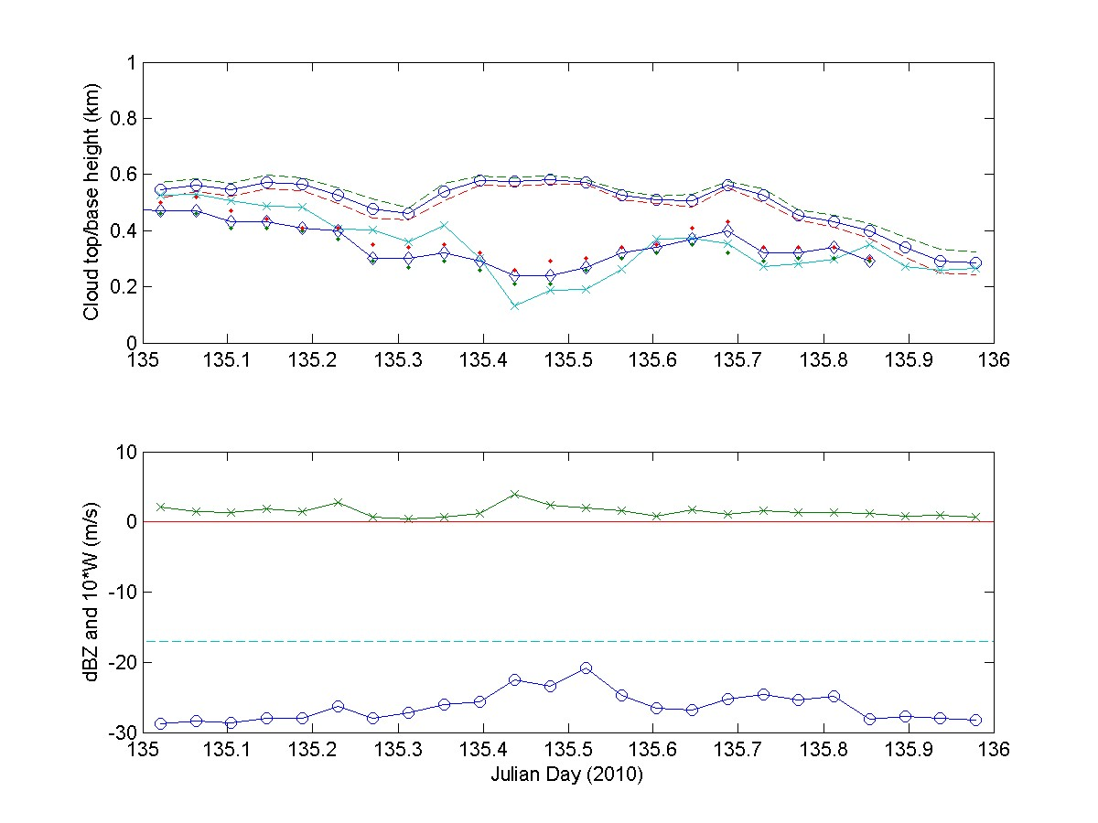
Combined Ceilometer – Cloud Radar
Time series of cloud properties for May 5, 2010. Upper panel: cloud top height (circle with solid line; ±1 standard deviation, dashed line) and cloud base height (diamonds with solid line; 1 standard deviation, dots). Lower panel: mean radar backscatter for the cloud/drizzle layer (circle with solid line) and mean droplet fall speed (x’s with solid line) multiplied by 10 (in m/s).

Slide 15
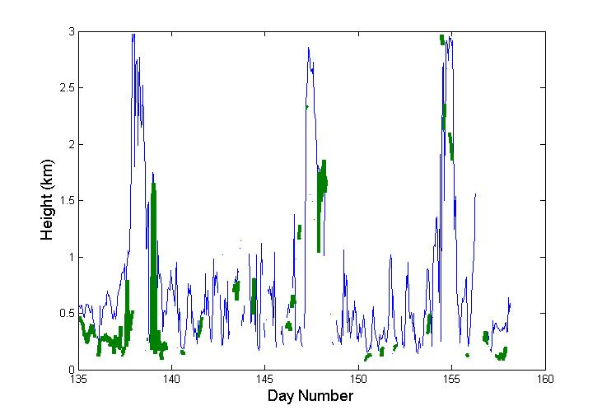
Time/height cross section of potential temperature
Time series of BL/Mixing height (blue) and cloud base height (green)

Slide 16
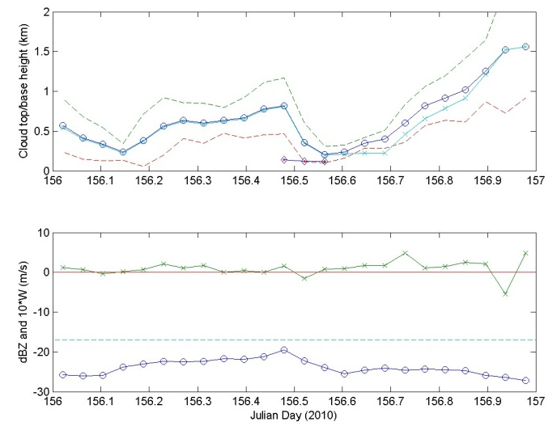
Year Day 156 May 23, 2010
Cloud Radar Returns from Non Cloud Targets (Bugs, pollen, bird???)
Upper panel: cloud top height from radar (circle with solid line; ±1 standard deviation, dashed line)
and cloud base height from ceilometer (diamonds with solid line; 1 standard deviation,
dots).
Lower panel: mean radar backscatter for the cloud/drizzle layer
(circle with solid line) and mean droplet fall speed (x’s with solid
line) multiplied by 10 (in m/s).

Slide 17
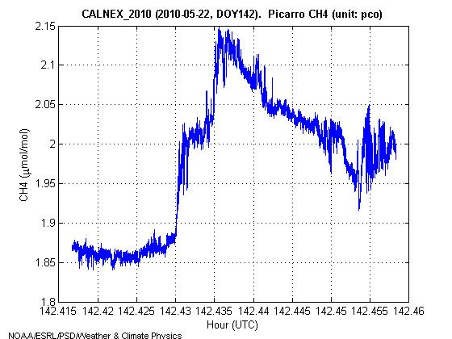
Measurements of CO2 and CH4 Blomquist/Huebert and Sweeney/McGillis
Blomquist – Picarro CRD CO2
Sweeney – Picarro CRD CO2/CH4, H2O
PSD – Licor7500 open path
Sample Methane Signal
Upper Panel – Detrended CO2 Picarro and Licor
Lower Panel – Detrended Humidity – Blue; Temperature – Green;Vertical Velocity – Red;Ship Vertical Motion - Cyan

